Slide 1
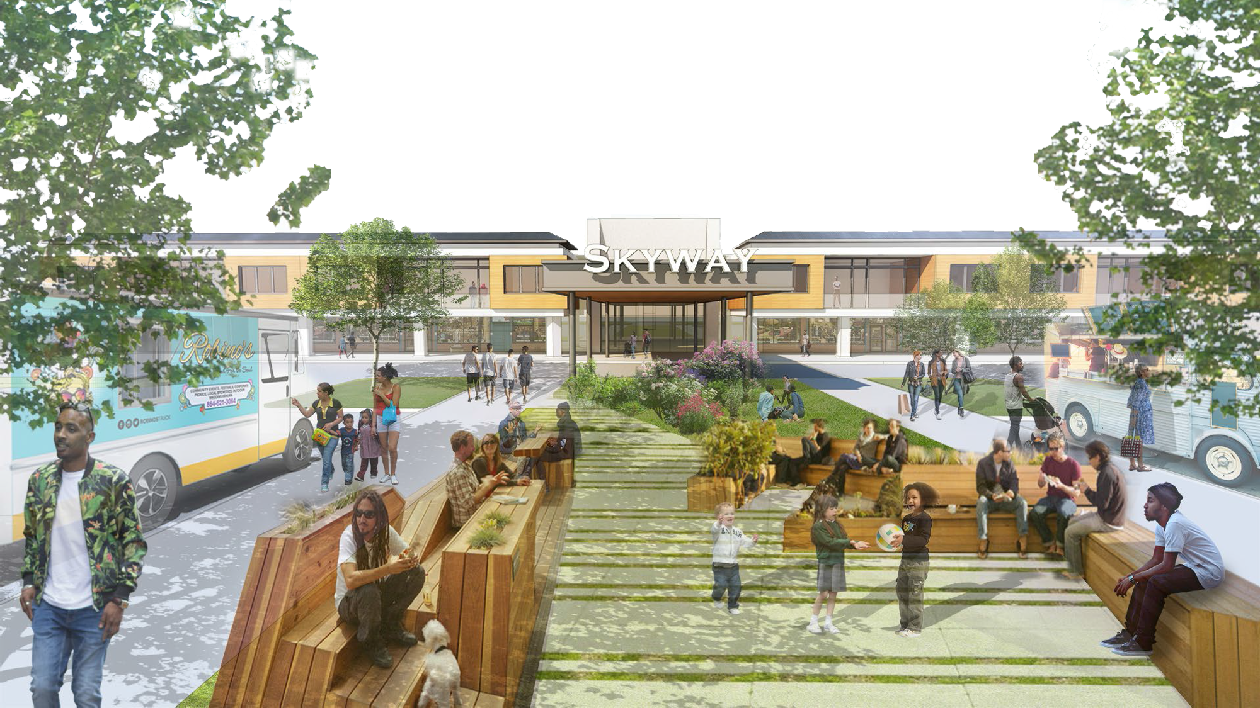
AFFORDABILITY – AVAILABILITY – OPPORTUNITY
Presented to the Greater Miami Chamber of Commerce
February 22, 2023
Ashon Nesbitt
CEO, Florida Housing Coalition

Slide 2
Florida Housing Coalition Partners with Florida Chamber
to Become Blueprint Goal Leader
Affordable Housing is Critical to the Quality of Life for All Floridians

Slide 3
The Florida Chamber has a housing goal in its 2030 Florida Blueprint plan to reduce the number of cost-burdened households to no more than 10% by the year 2030.

Slide 4
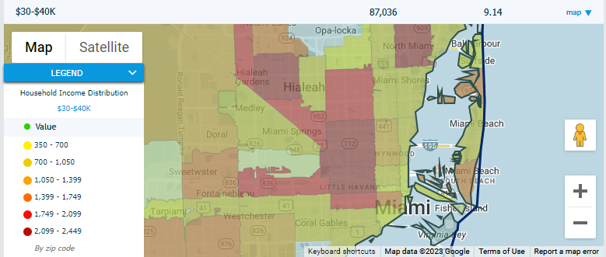
Primary Causes of Cost Burden and Who Is Most Affected
Primary Causes
Insufficient Wages
High housing costs
Who is Most Cost-Burdened
Renters
Households earning 50% of AMI or less
Map Source: Miami-Dade Beacon Council https://www.beaconcouncil.com/data/demographic-overview/todays-miami/

Slide 5
How to Create Housing Affordability?
Planning + Financing + Long Term Assurances = Affordability
Affordability

Slide 6
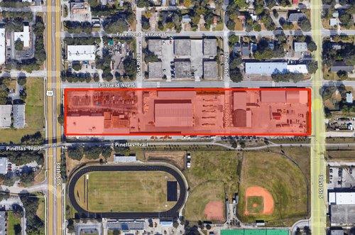
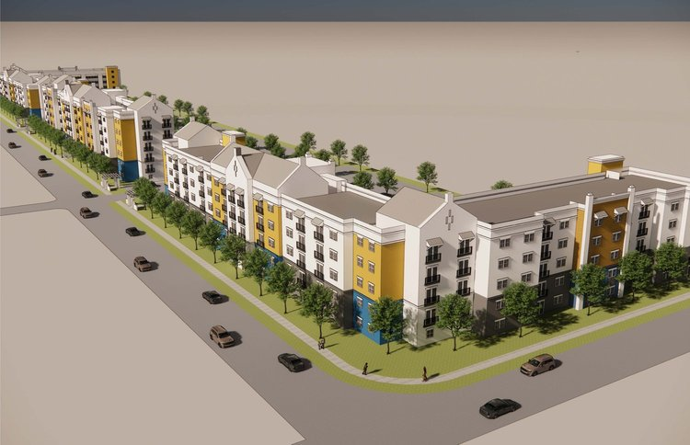
Example: Fairfield Apartments in St. Petersburg
Lumber yard in St. Petersburg to become 264-units
of mixed-income housing
Photo credits: www.stpeterising.com

Slide 7
Example: Fairfield Apartments
Income Mix
53 units – up to 50% AMI
67 units – between 50% and 80% AMI
144 units – between 80% and 120% AMI
Proportionally mixed among all bedroom sizes
Planning: Utilizing HB1339 flexibility and affordable housing density bonus
Financing: Capital Stack
HUD 211(d)(4) – $42,548,733
Pinellas County Penny IV - $5,600,000 for land acquisition
City of St. Petersburg CRA - $2,281,689
Owner’s Equity – $2,318,311
Long Term Assurances: Will be in the County’s land trust and permanently affordable
Photo source: www.stpeterising.com

Slide 8
What Can the Business Community Do?

Slide 9
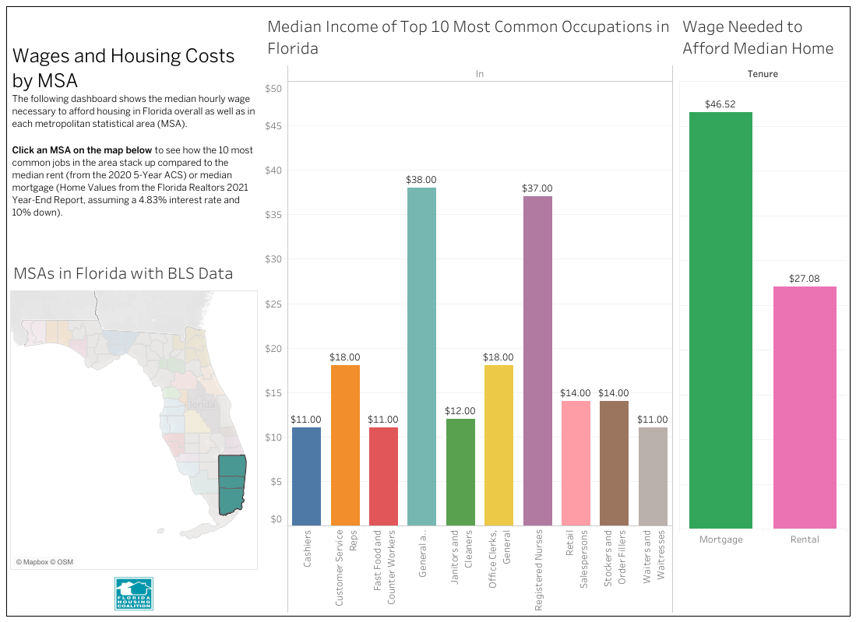
(Re)define the “Workforce”
Typical “Workforce” definition - between 100% and 140% of AMI
Greater Miami Chamber – 60% AMI and up
Other terms synonymous with workforce: “essential works” or “heroes”
Teachers, police officer, firefighters, healthcare workers
What jobs and income levels make up most of the actual “Workforce”?
Where do your employees fall on the income level chart?

Slide 10
Income Scale | 2- person | 3-person | 4-person | 6-person
140% AMI | $109,200 | $122,920 | $136,500 | $158,340
100% AMI | $78,000 | $87,800 | $97,500 | $113,100
80% AMI | $62,400 | $70,240 | $78,000 | $90,480
60% AMI | $46,800 | $52,680 | $58,500 | $67,860
50% AMI | $39,000 | $43,900 | $48,750 | $56,550
Source: Florida Housing Finance Corporation https://www.floridahousing.org/docs/default-source/developers-and-property-managers/compliance/limits/income-limits/ship-and-hhrp---2022-combined-income-and-rent-limits-(eff-4-18-2022).pdf?sfvrsn=e039f57b_0

Slide 11
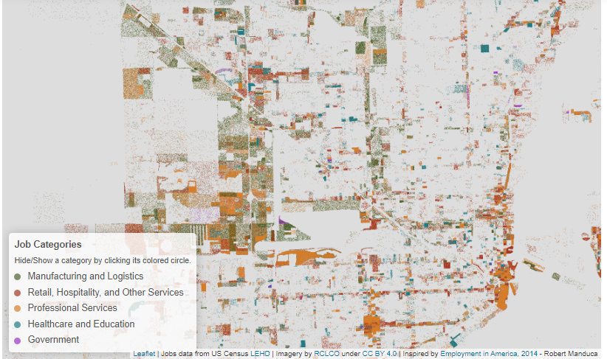
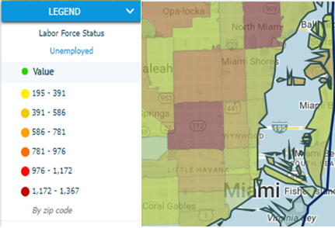
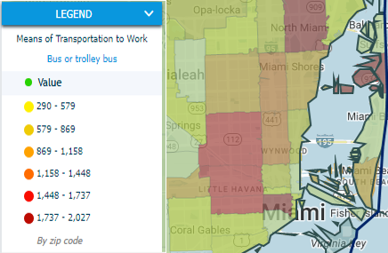
Jobs Concentration Map by RCLCO: https://www.rclco.com/publication/jobs-across-america-an-interactive-map-of-employment-density-by-industry/
Map Source: Miami-Dade Beacon Council https://www.beaconcouncil.com/data/demographic-overview/todays-miami/

Slide 12
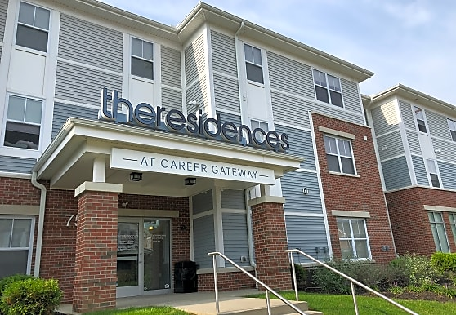
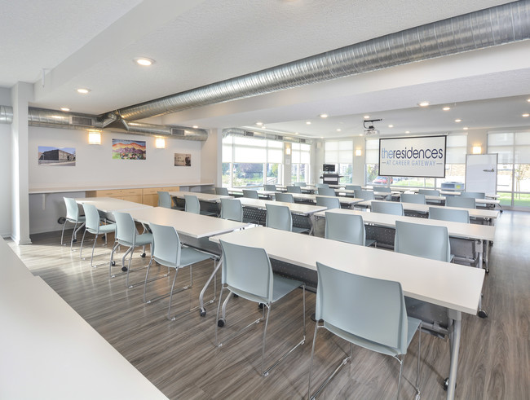
Support Employees
Understand the housing needs of your workforce
Match workforce training with housing
Consider employer assisted housing programs
Matched savings
Purchase assistance
Homebuyer education
Rental deposits
Consider supporting other needs such as childcare and transportation
The Residences at Career Gateway in Columbus, OH;
Nationwide Children’s Hospital offers workforce training and career coaching onsite.
Photo credits: www.apartmentguide.com and www.apartments.com

Slide 13
Other Ways the Business Community Can Get Involved
Support those that are doing the work
Philanthropic giving to nonprofits
Volunteer to serve on a Board
Provide technical expertise and connections that would benefit residents
Support good projects and policy
Show up to public meetings in support
Identify opportunities at the intersection of various plans and programs

Slide 14
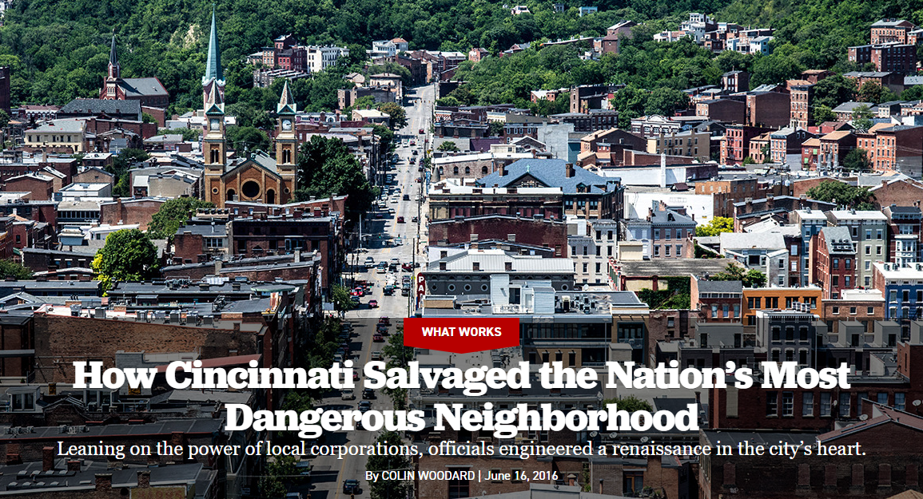
Case Study: Over-the-Rhine, Cincinnati, OH
Creation of a privately funded, nonprofit development corporation led by the business community.
Privately created nonprofit development corporation, Cincinnati Central City Development Corporation (3CDC)
Array of creative financing and PPP
Creation of the $50 million Cincinnati New Markets Fund allowed 3CDC to buy property within an area defined by a strategic vision and to partner with developers who shared the same goals.
3CDC invested over $27 million in private funds to buy 200 buildings and 170 vacant parcels.
Sources: https://www.politico.com/magazine/story/2016/06/what-works-cincinnati-ohio-over-the-rhine-crime-neighborhood-turnaround-city-urban-revitalization-213969/
https://casestudies.uli.org/wp-content/uploads/2016/06/OverTheRhinePDF.pdf

Slide 15
Outcomes: Over-the-Rhine, Cincinnati, OH
Restored 144 buildings, including housing and street front commercial establishments
Constructed 50 new buildings
Added 1,113 housing units (condominiums, apartments, and townhouses)
Provided 320 shelter beds
Added 156 hotel rooms
Created 845,000 square feet of commercial space
Added 2,700 parking spaces
Revitalized ten acres of parks
Incentivized millions of dollars in streetscape improvements

Slide 16
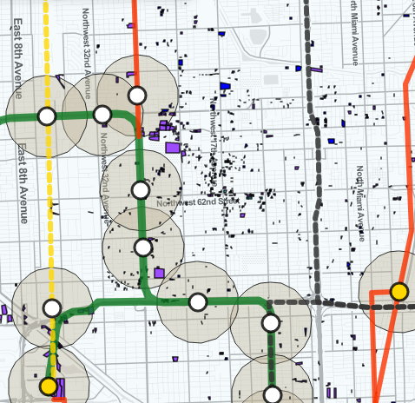
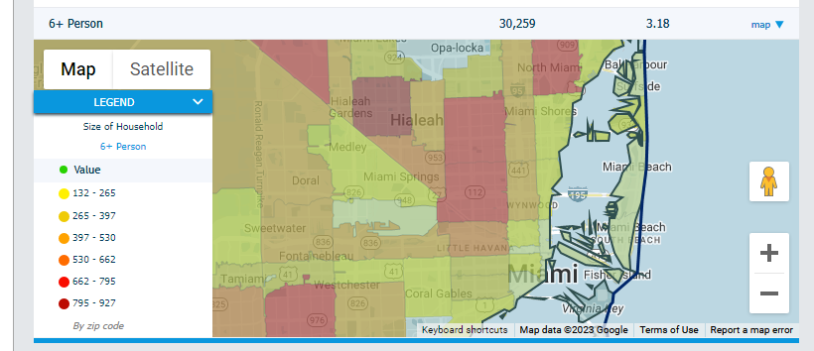
Map Source: University of Miami https://land.ccs.miami.edu/explore/parcels
Map Source: Miami-Dade Beacon Council https://www.beaconcouncil.com/data/demographic-overview/todays-miami/

Slide 17
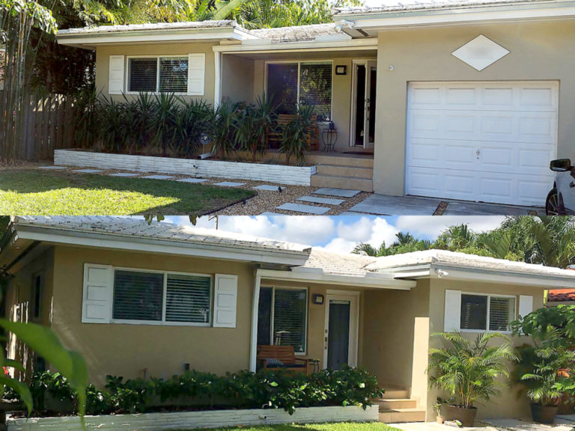
At the Intersection: Accessory Dwelling Units
Role for Local Government
Allow pre-approved designs
Prioritize for Infill Program
Gap financing – Surtax, CDBG, HOME, SHIP, TIF, etc.
Roles for Design professionals
Create pre-approved designs
Pro bono or discounted services
Role for Finance professionals
Loan products for purchase and/or renovation
Special purpose program
Photo Credit: Rausa Builders https://www.rausabuilders.com/garage-conversion-city-miami/

Slide 18
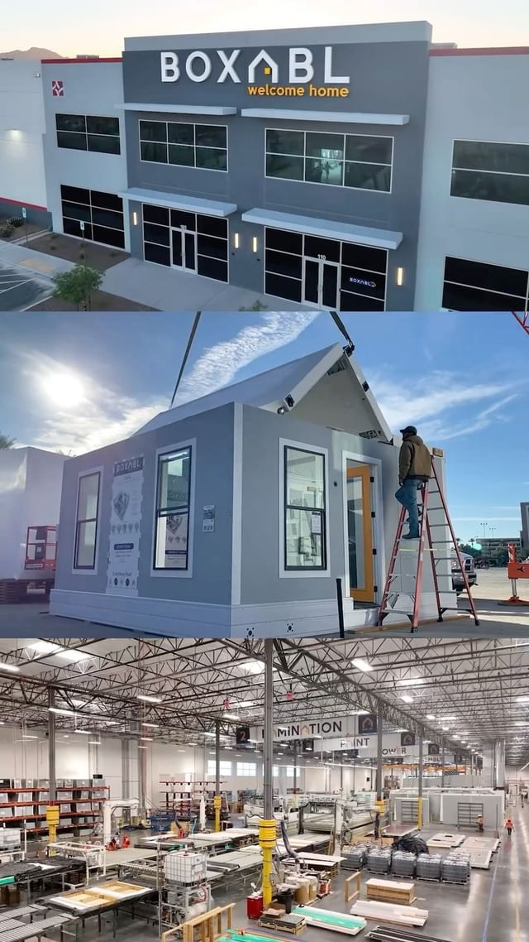
At the Intersection: Accessory Dwelling Units
Role for Nonprofits/Philanthropy
Program administration
Technical assistance for property owners
Role for Innovators
Pre-fabricated design and production
Hire residents to get into the workforce
Photo Credit: Boxabl https://www.boxabl.com/gallery

Slide 19
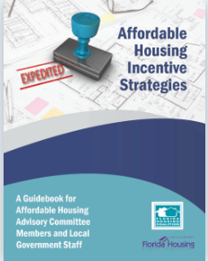
Florida Housing Coalition (FHC) Technical Assistance is Available
FHC Staff is Available Daily
1-800-677-4548
Options for Further Assistance Include:
Phone and Email Consultation
Site Visits
Register at www.flhousing.org for
Workshops
Webinars
Previous trainings
Publications

Slide 20
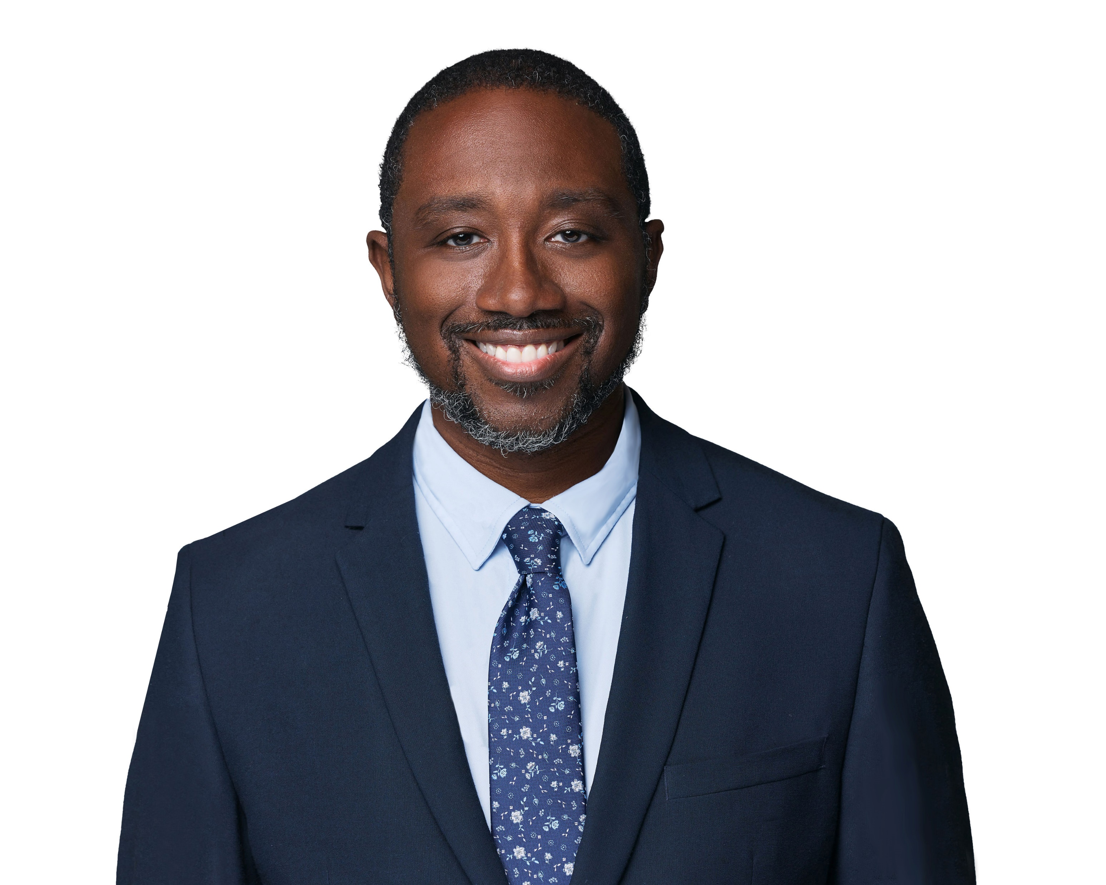
Thank you
Ashon Nesbitt
Chief Executive Officer
nesbitt@flhousing.org
813-476-4170

