Slide 1





Department of Transportation and Public Works
(DTPW)
South Corridor Rapid Transit Project
Project Update
Prepared for: The Greater Miami Chamber of Commerce
Town Hall Meeting - Transportation
Aug 15, 2018
SMARTSouth@miamidade.gov
www.miamismartplan.com
#MiamiSMARTPlan

Slide 2

Miami-Dade County SMART Plan
Six Corridors:
Beach Corridor
East-West Corridor
Kendall Corridor
North Corridor
Northeast Corridor
South Corridor
www.miamismartplan.com
www.miamismartplan.com
#MiamiSMARTPlan
SMARTSouth@miamidade.gov
#MiamiSMARTPlan
SOUTH CORRIDOR

Slide 3
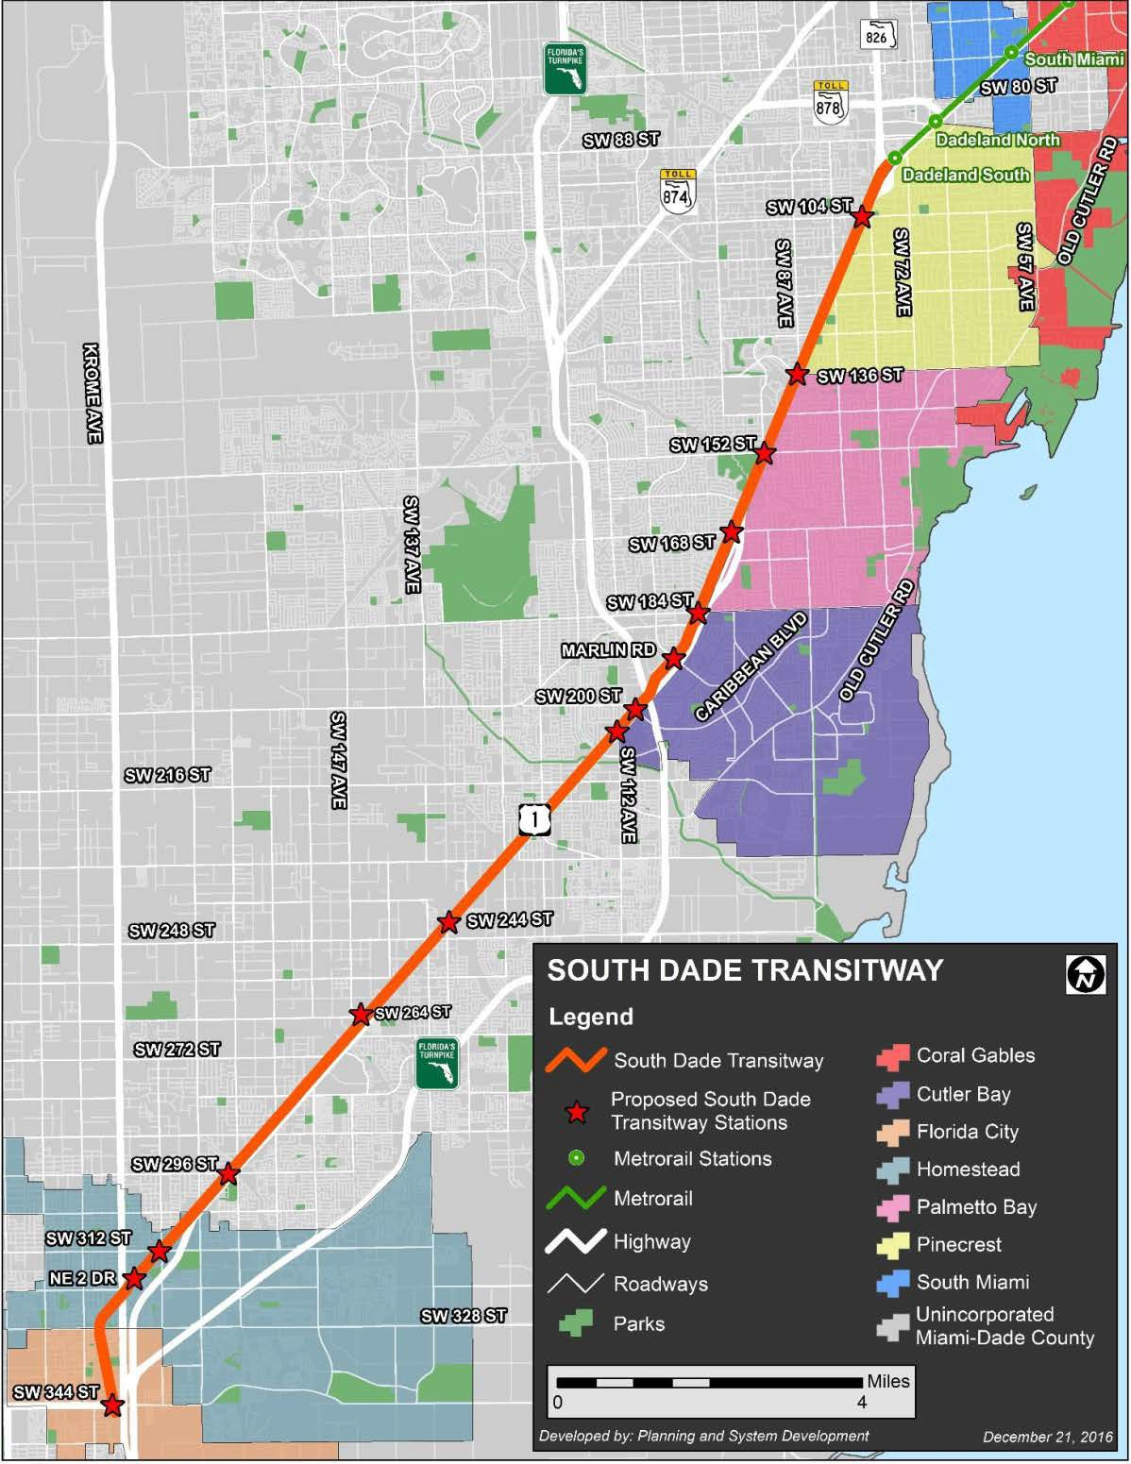
Basic Facts
Length of Corridor
- 20 Miles exclusive transit right-of-way, parallel to US-1
Population
89,040 (1/2-mile buffer)
326,000 (2-mile buffer)
Density (population/square mile) = 4,450 based on ½-mile buffer
  Source: American Community Survey 2015
Employment
55,229 (1/2-mile radius)
87,000 (2-mile radius)
Density (employment/square mile) = 2,760 based on ½- mile buffer
  Source: LEHD Origin-Destination Employment Statistics 2015
Daily Traffic on US-1 (AADT)
28,000 to 95,000 vehicles
  Source: FDOT (2016) at South Terminus of Palmetto Expressway
Transitway Usage Today
About 13,500 boarding's per day
  1,980 Boarding’s on RT34 (34A)
  730 Boarding’s RT39 (34B)
  Source: Miami-Dade DTPW (April, 2018)
www.miamismartplan.com
www.miamismartplan.com
#MiamiSMARTPlan
SMARTSouth@miamidade.gov
#MiamiSMARTPlan
SOUTH CORRIDOR

Slide 4
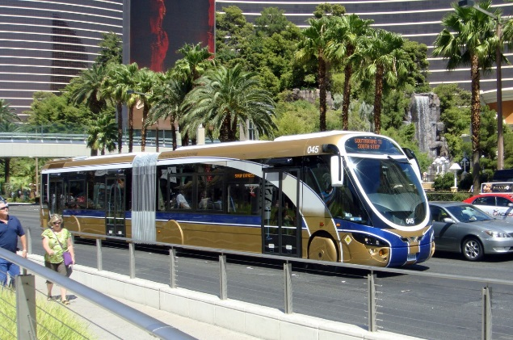
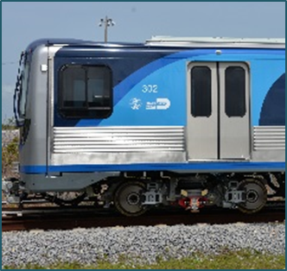
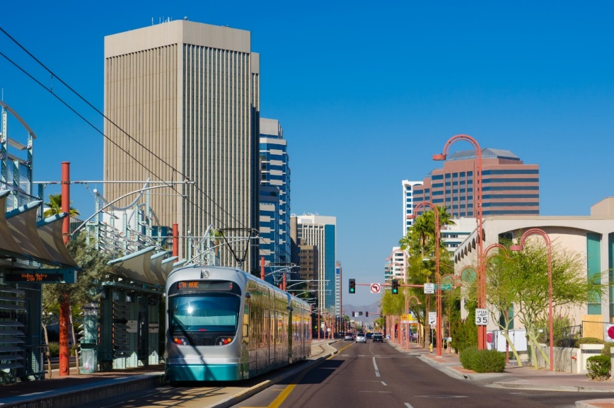

Study Objectives: Evaluate Transit Alternatives
Bus Rapid Transit (BRT)
Heavy Rail Transit (HRT)
Eliminated due to equivalent cost to Metrorail at-grade (does not provide one-seat ride)
Accommodated as future consideration
Light Rail Transit (LRT)
Connected and Autonomous Vehicle (CAV)
www.miamismartplan.com
www.miamismartplan.com
#MiamiSMARTPlan
SMARTSouth@miamidade.gov
#MiamiSMARTPlan
SOUTH CORRIDOR

Slide 5
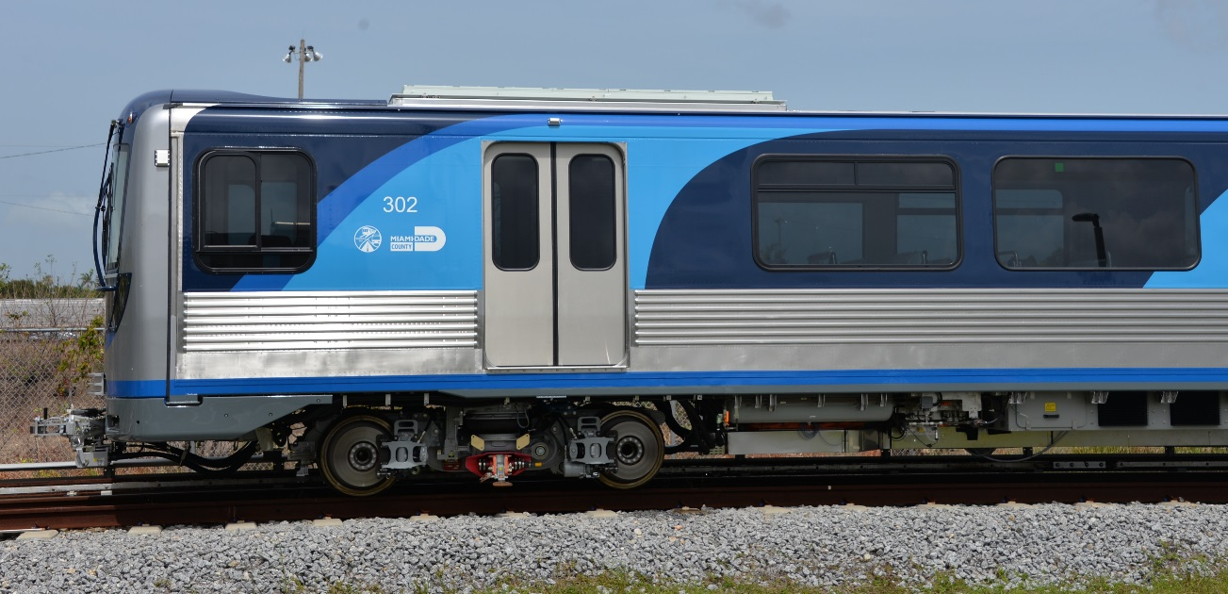
What is HRT
existing Miami Metrorail at ground level
electrically powered
high capacity
high speed
multi-car trains on fixed rails
exclusive right-of-way
sophisticated signaling
high platform loading
www.miamismartplan.com
www.miamismartplan.com
#MiamiSMARTPlan
SMARTSouth@miamidade.gov
#MiamiSMARTPlan
SOUTH CORRIDOR
Notes:
Show two maps, BRT and HRT side by side

Slide 6
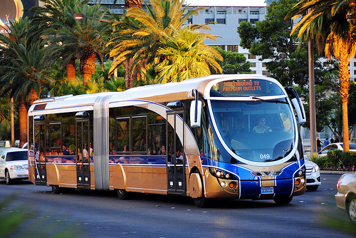
What is BRT
high-quality bus-based transit system
dedicated lanes
transit signal preemption
fast
comfortable
cost-effective
high capacity
iconic stations
off-board fare collection
frequent operations
www.miamismartplan.com
www.miamismartplan.com
#MiamiSMARTPlan
SMARTSouth@miamidade.gov
#MiamiSMARTPlan
SOUTH CORRIDOR
Notes:
Show two maps, BRT and HRT side by side

Slide 7
BRT Video Rendering
www.miamismartplan.com
www.miamismartplan.com
#MiamiSMARTPlan
SMARTSouth@miamidade.gov
#MiamiSMARTPlan
SOUTH CORRIDOR

Slide 8

BRT/HRT Element Comparison
Element | BRT | HRT Metrorail (at-grade)
Flexibility
Shorter Headways
Travel Time
Crossing Gatearms
Express Routes
Level Boarding
Off-board Fare Collection
Rail One-Seat Ride
www.miamismartplan.com
www.miamismartplan.com
#MiamiSMARTPlan
SMARTSouth@miamidade.gov
#MiamiSMARTPlan
SOUTH CORRIDOR
Notes:
Show two maps, BRT and HRT side by side

Slide 9
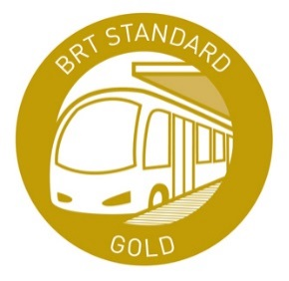
Recommended Alternative
Why BUS RAPID TRANSIT ?
Same or better travel times than Rail (with crossing gates)
Right sized solution for projected ridership
Greater Flexibility than Rail (vehicles can go off corridor)
Federal & State Funding Opportunity
Helps Corridor Increase Ridership towards future rail
Implements elements needed for rail
Iconic Stations that encourage Economic Development and Transit Oriented Development (TOD)
Major improvements at Dadeland South to Provide Easy Transfer
Affordable (20% of the capital cost of Rail and 25% of the O&M)
Begin Operation in 3 to 4 Years
Minimal impact during construction
The proposed BRT service targets achieving the highest BRT standard – Gold Standard
www.miamismartplan.com
www.miamismartplan.com
#MiamiSMARTPlan
SMARTSouth@miamidade.gov
#MiamiSMARTPlan
SOUTH CORRIDOR

Slide 10
Public Engagement
Meetings:
Agency Kick-Off Meeting held on May 5th, 2017
Public Kick-Off Meeting held on May 31st, 2017
Corridor Workshops – 3 meetings (North, Central and South)
Meetings with stakeholders and community groups (11 meetings)
Project Advisory Group (PAG) – 4 meetings
One-on-One Meetings (28 meetings)
Presentations to each Municipality – (10 meetings)
TPO Committee & CITT Presentations– (6 meetings)
Alternatives Workshops – 3 meetings (North, Central and South)
Project email, website, and social media
Over 65 Meetings
City Resolutions of Support:
City of Pinecrest
City of Homestead
City of Florida City
Organizations Supporting BRT:
Miami Herald Editorial Board
Latin Builders Association (LBA)
Builder Association of South Florida (BASF)
Engineering Contractors Association of South Florida (ECA)
www.miamismartplan.com
www.miamismartplan.com
#MiamiSMARTPlan
SMARTSouth@miamidade.gov
#MiamiSMARTPlan
SOUTH CORRIDOR

Slide 11
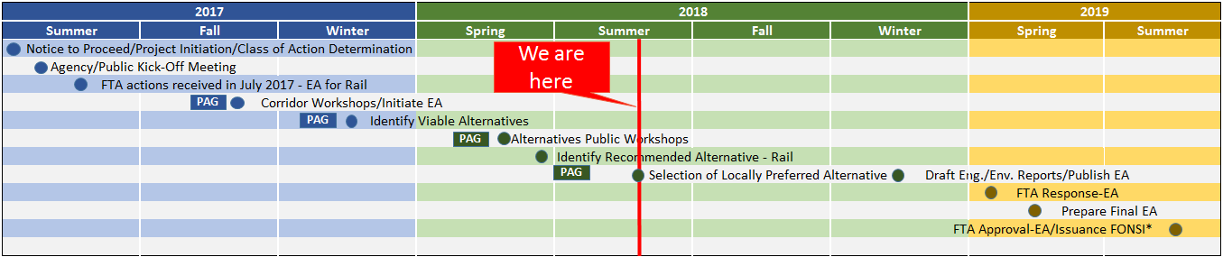
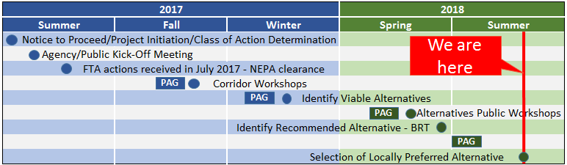
NEPA Study Schedule: Rail vs. Bus Rapid Transit
Typical Schedule Rail¹
¹DTPW has received EA Class of Action determination for Rail (Begin HRT service in approximately 8 to 10 years)
Typical Schedule BRT²
²DTPW has received NEPA clearance from FTA for BRT (Begin BRT service in approximately 3 to 4 years)
www.miamismartplan.com
www.miamismartplan.com
#MiamiSMARTPlan
SMARTSouth@miamidade.gov
#MiamiSMARTPlan
SOUTH CORRIDOR

Slide 12
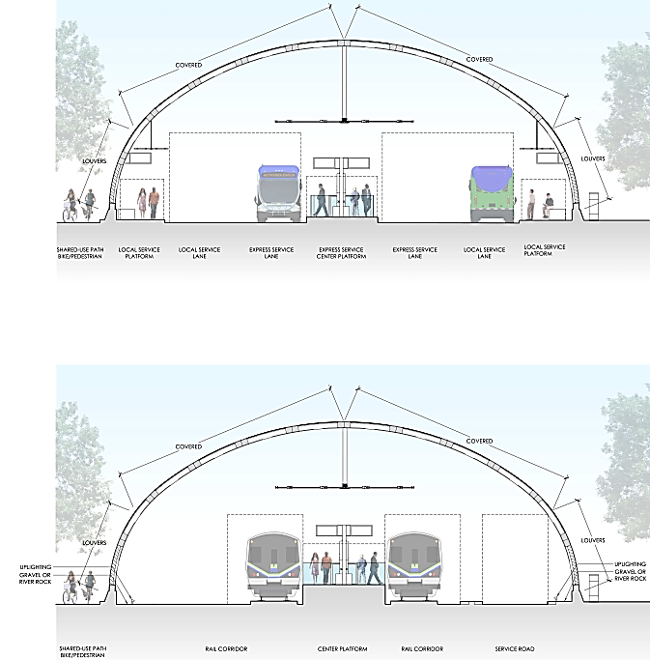
Typical Alternatives
POTENTIAL FOR AC VESTIBULE
When converting to rail, stations would be lengthened and platform will be raised
ccccccccc
POTENTIAL FOR AC VESTIBULE
ccccccccc
HIGHER PLATFORM
www.miamismartplan.com
www.miamismartplan.com
#MiamiSMARTPlan
SMARTSouth@miamidade.gov
#MiamiSMARTPlan
SOUTH CORRIDOR
Notes:
Put in a emergency vehicle on the Service Road (HRT Typical)
Develop typical with Vault station on the same location to show transition from BRT to HRT

Slide 13
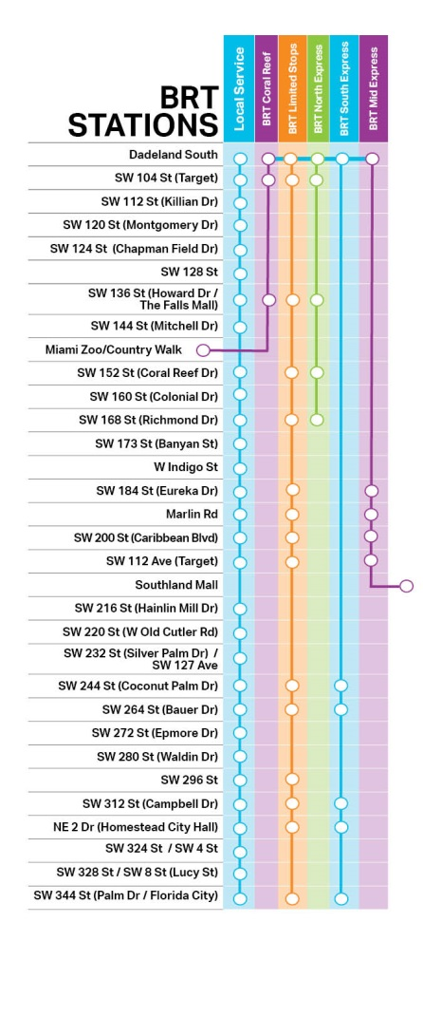
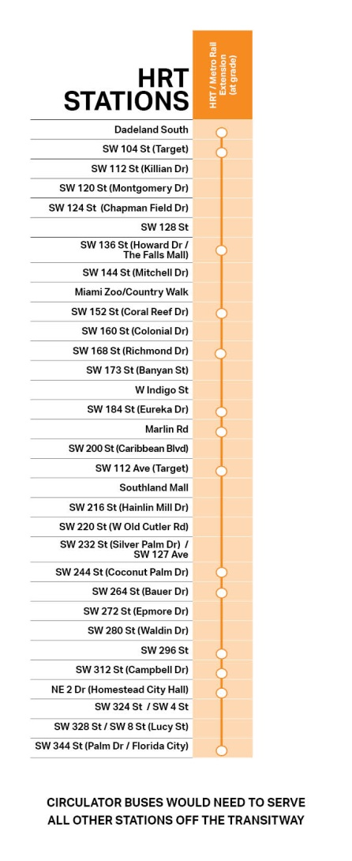
Proposed Operation Plans
www.miamismartplan.com
www.miamismartplan.com
#MiamiSMARTPlan
SMARTSouth@miamidade.gov
#MiamiSMARTPlan
SOUTH CORRIDOR
Notes:
Show two maps, BRT and HRT side by side

Slide 14
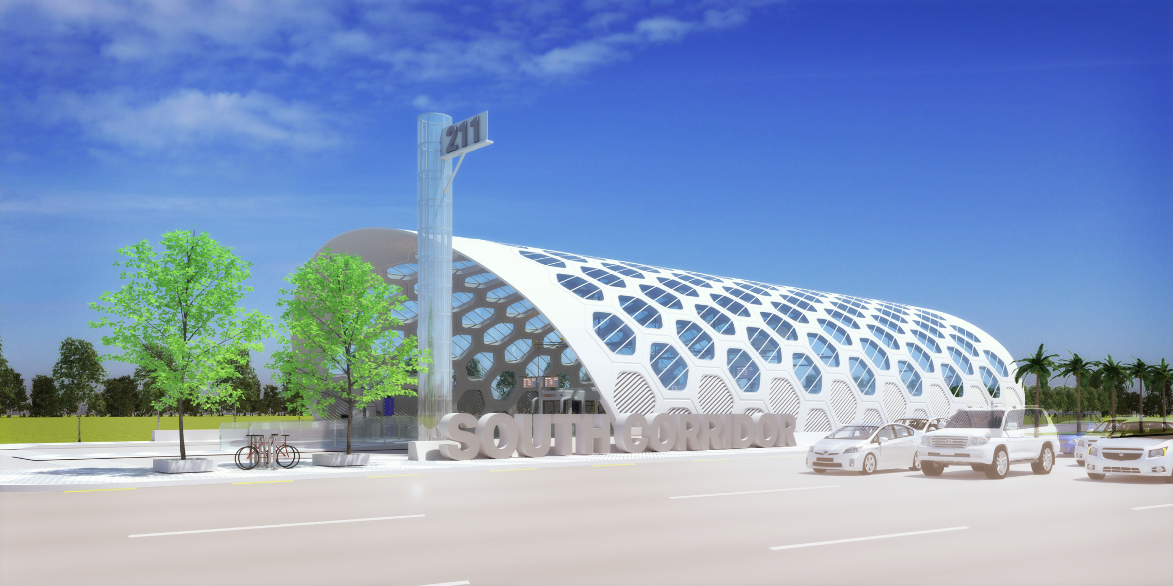
Preliminary Station Renderings (BRT)
www.miamismartplan.com
www.miamismartplan.com
#MiamiSMARTPlan
SMARTSouth@miamidade.gov
#MiamiSMARTPlan
SOUTH CORRIDOR

Slide 15
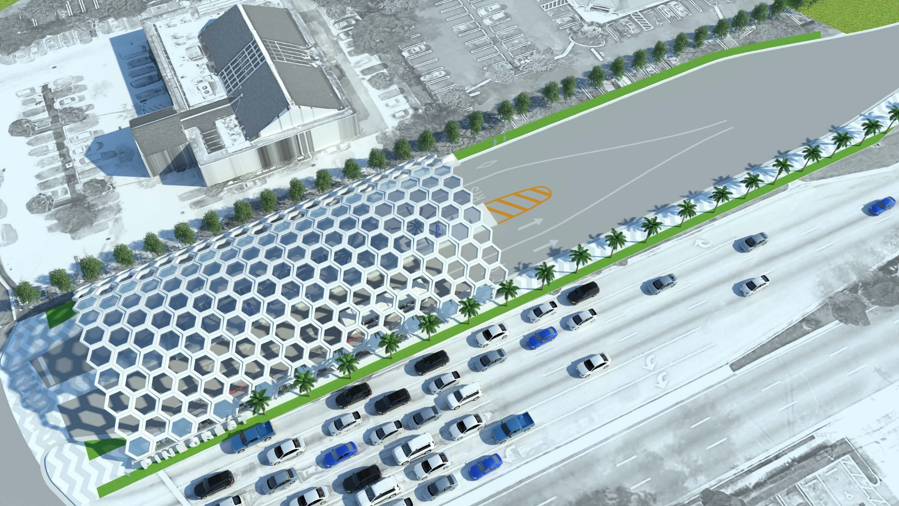
Preliminary Station Renderings (BRT)
www.miamismartplan.com
www.miamismartplan.com
#MiamiSMARTPlan
SMARTSouth@miamidade.gov
#MiamiSMARTPlan
SOUTH CORRIDOR

Slide 16
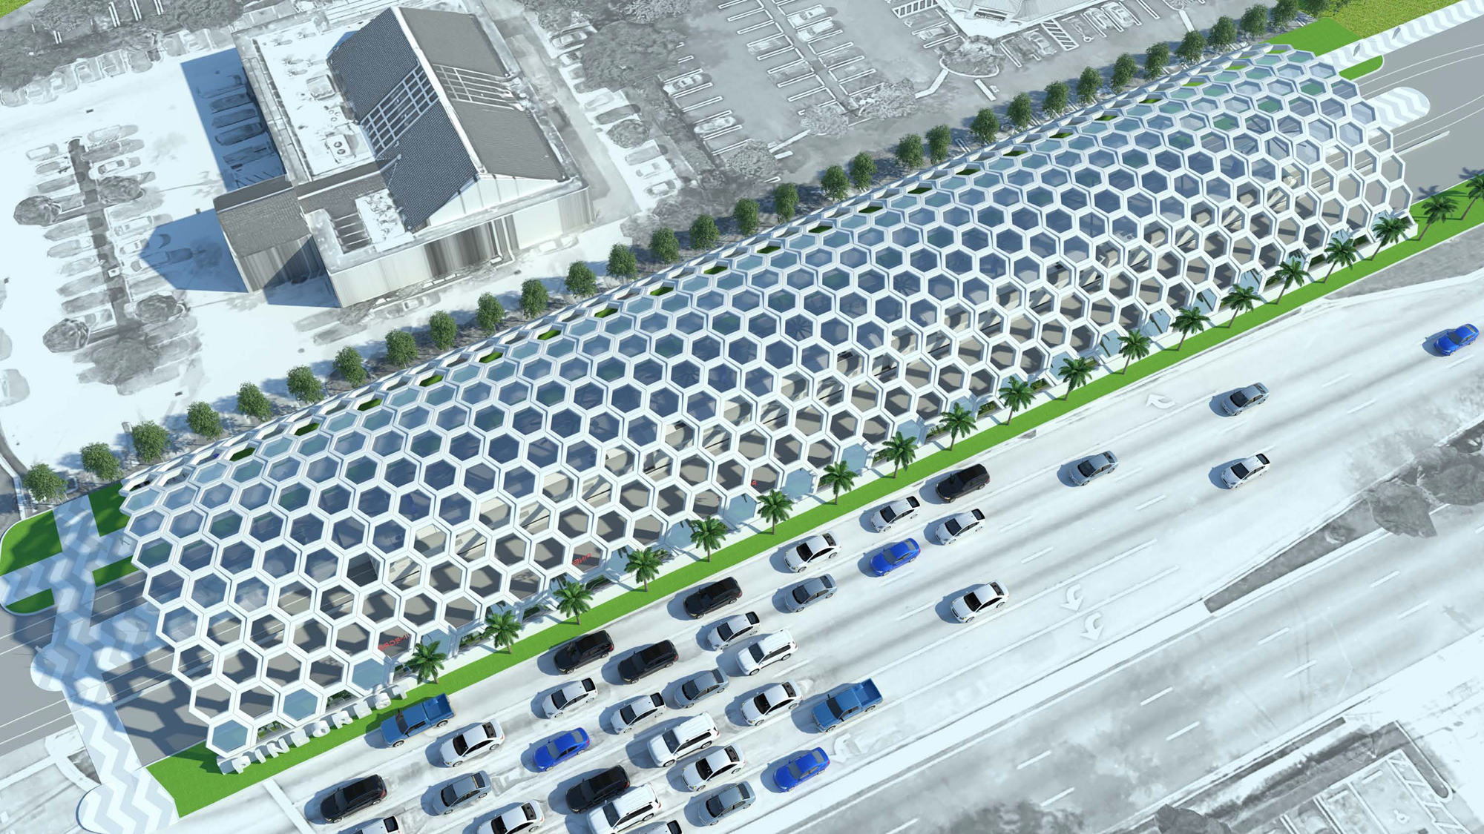
Preliminary Station Renderings (HRT)
www.miamismartplan.com
www.miamismartplan.com
#MiamiSMARTPlan
SMARTSouth@miamidade.gov
#MiamiSMARTPlan
SOUTH CORRIDOR

Slide 17
SMART Plan Cost/Funding Available
Mode | Capital Cost ($2017 Million) | Yearly O&M (Million)* | O&M Pro Forma Impact Through 2057** | New Transit Ridership by 2040
Bus Rapid Transit | $243 | $15 | $865M | 10,000 to 11,000
High Rail Transit (at-grade) | $1,332 | $67 | $4.2B | 16,000 to 18,000
* O&M costs do not include circulator/feeder buses that would be required for HRT to serve all original stations
** Net of Fare Box Revenue
www.miamismartplan.com
www.miamismartplan.com
#MiamiSMARTPlan
SMARTSouth@miamidade.gov
#MiamiSMARTPlan
SOUTH CORRIDOR

Slide 18
Successful BRT Projects
BRT Line | Length (miles) | Year Opened | Daily Ridership
1st/2nd Avenue Select Bus Service - New York, NY | 9 | 2010 | 45,000
Fordham Road Select Bus Service - Bronx, NY | 9 | 2010 | 35,000
Orange Line - Los Angeles, CA | 18 | 2005 | 30,000
Silver Line - Boston, MA | 6.4 | 2010 | 26,000
East Busway - Pittsburgh, PA | 9.1 | 1983 | 25,000
Vermont Avenue - Los Angeles, CA | 12.5 | 2004 | 22,000
SDX line - Las Vegas, NV | 9 | 2010 | 14,000
Health Line - Cleveland, OH | 9.4 | 2008 | 14,000
Silver Line - Los Angeles, CA | 26.7 | 2009 | 14,000
Emerald Express - Eugene, OR | 4 | 2007 | 11,000
Metrovía – Guayaquil, Ecuador | 28.2 | 2006 | 430,000
www.miamismartplan.com
www.miamismartplan.com
#MiamiSMARTPlan
SMARTSouth@miamidade.gov
#MiamiSMARTPlan
SOUTH CORRIDOR
Notes:
Pics: LA, NY, Chicago, Boston, Cleveland, See GOA report

Slide 19
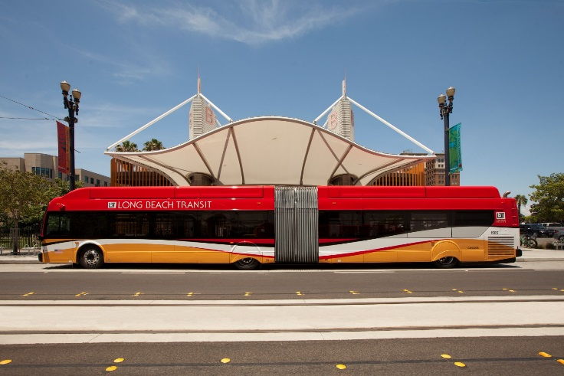
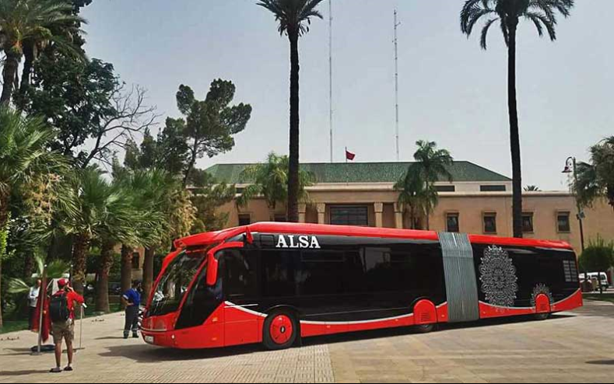
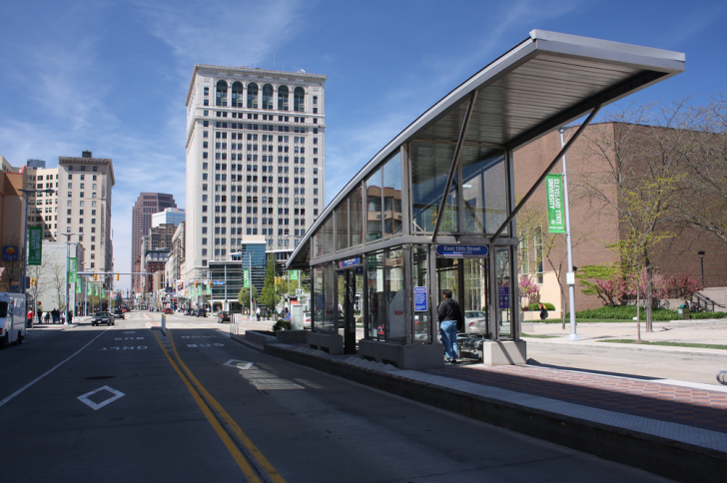
BRT Examples
www.miamismartplan.com
www.miamismartplan.com
#MiamiSMARTPlan
SMARTSouth@miamidade.gov
#MiamiSMARTPlan
SOUTH CORRIDOR

Slide 20
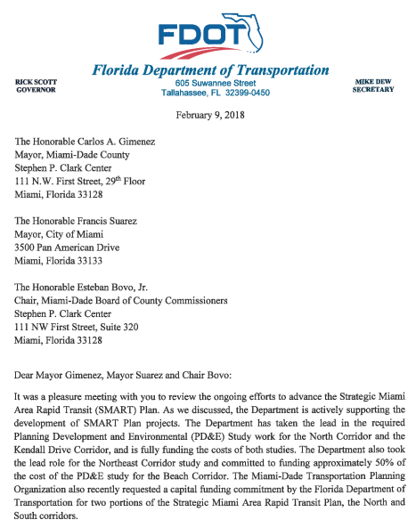
Recommended Alternative
Why BUS RAPID TRANSIT ?
Same or better travel times than Rail (with crossing gates)
Right sized solution for projected ridership
Greater Flexibility than Rail (vehicles can go off corridor)
Federal & State Funding Opportunity
Helps Corridor Increase Ridership towards future rail
Implements elements needed for rail
Iconic Stations that encourage Economic Development and Transit Oriented Development (TOD)
Major improvements at Dadeland South to Provide Easy Transfer
Affordable (20% of the capital cost of Rail and 25% of the O&M)
Begin Operation in 3 to 4 Years
Minimal impact during construction
www.miamismartplan.com
www.miamismartplan.com
#MiamiSMARTPlan
SMARTSouth@miamidade.gov
#MiamiSMARTPlan
SOUTH CORRIDOR

Slide 21
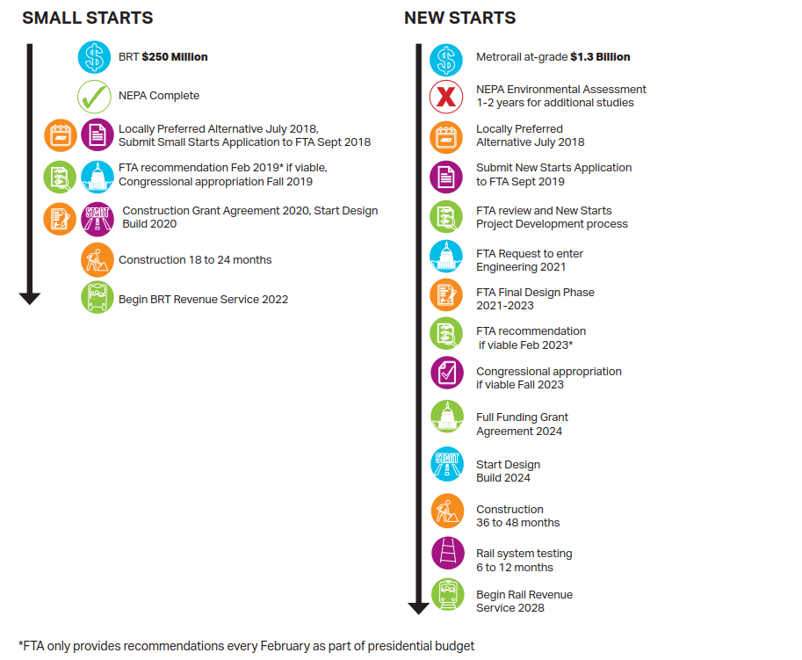
Federal Capital Investment Grant (CIG) Process
Bus Rapid Transit (BRT)
Heavy Rail Transit (HRT)
(BRT)
(HRT)
www.miamismartplan.com
www.miamismartplan.com
#MiamiSMARTPlan
SMARTSouth@miamidade.gov
#MiamiSMARTPlan
SOUTH CORRIDOR

Slide 22
Preliminary Benefit Cost Analysis
Cost Effective
HRT (at Grade)
Threshold ($9.99 per rider)
Current Ridership
Not Cost Effective
Demonstration of FTA Cost effectiveness analysis
www.miamismartplan.com
www.miamismartplan.com
#MiamiSMARTPlan
SMARTSouth@miamidade.gov
#MiamiSMARTPlan
SOUTH CORRIDOR
Notes:
Current Ridership level on Transitway is about 15,000 riders
*Ridership is daily weekday

Slide 23
BRT and HRT use of Conceptual Financial Plan Funds
Rapid Transit Corridor Conceptual Financial Plan funding available for
Capital, Financing, O&M and Replacement over 40 years
$8.457 billion
www.miamismartplan.com
www.miamismartplan.com
#MiamiSMARTPlan
SMARTSouth@miamidade.gov
#MiamiSMARTPlan
SOUTH CORRIDOR

Slide 24
BRT and HRT use of Conceptual Financial Plan Funds
www.miamismartplan.com
www.miamismartplan.com
#MiamiSMARTPlan
SMARTSouth@miamidade.gov
#MiamiSMARTPlan
SOUTH CORRIDOR

Slide 25
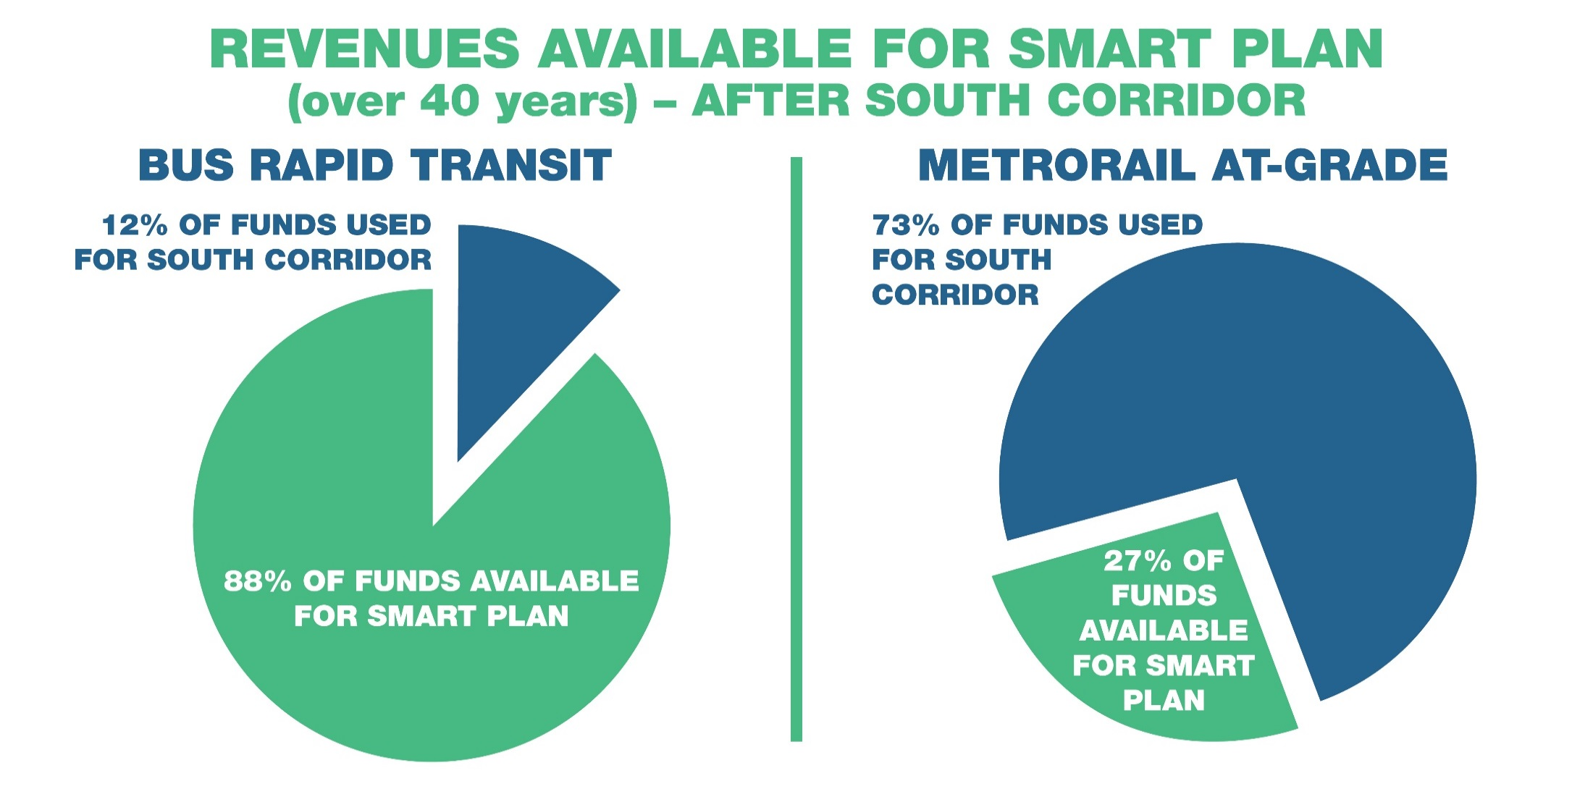
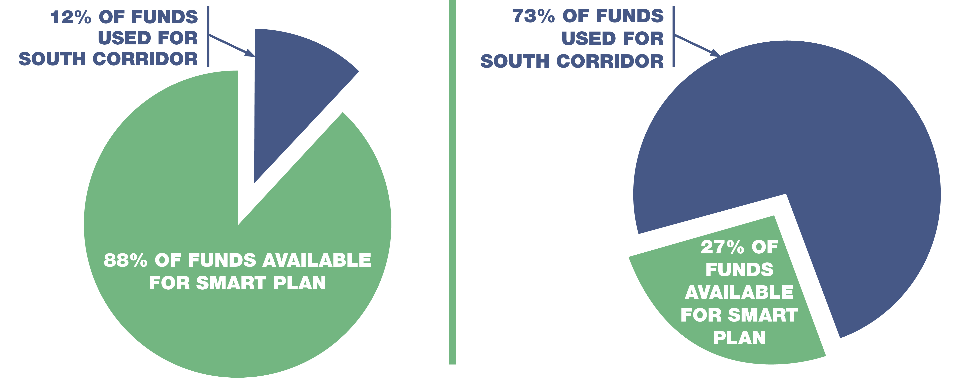
Reserves Available for SMART Plan (Over 40 Years)
– After South Corridor
www.miamismartplan.com
www.miamismartplan.com
#MiamiSMARTPlan
SMARTSouth@miamidade.gov
#MiamiSMARTPlan
SOUTH CORRIDOR

Slide 26
FTA CIG Funding Program
Approved versus actual
14 current FFGAs with a total of $12,347.27 M recommended
$6,300.34 M appropriated thru FY17
Approved with $0 (FY 2018)
2 projects, the Peninsula Corridor (requesting $647M) and Maryland
Purple Line (requesting $900M)
In Pipeline:
New Starts – 14
Core Capacity – 5
Small Starts – 32
Federal funding available: $2.3 billion per year
www.miamismartplan.com
www.miamismartplan.com
#MiamiSMARTPlan
SMARTSouth@miamidade.gov
#MiamiSMARTPlan
SOUTH CORRIDOR

Slide 27
Current Federal Small Starts Opportunity
Small Starts program is geared toward faster delivery
Project Cost under $300 million, lower federal funding support
Opportunity to apply for federal funding in the coming Fiscal Year 2019/2020
Project delivery/start of operations as early as 3 to 4 years
BRT implements stations and gate arms that are needed for future rail
Recommendation:
Selection of Bus Rapid Transit as the Locally Preferred Alternative (LPA)
www.miamismartplan.com
www.miamismartplan.com
#MiamiSMARTPlan
SMARTSouth@miamidade.gov
#MiamiSMARTPlan
SOUTH CORRIDOR

