Slide 1
Bus Rapid Transit

Slide 2
Types of “BRT”
Simplest | Stations | Running Ways | Service Plan | Vehicles | Systems
“Rapid Bus,” “BRT Lite” | “Super” Stops, Shelter | Mixed Traffic, Queue Jumpers | Trunk/ Feeder: Single All-Stops Trunk Line | Buses with Unique Rte. ID’s, Head Signs, livery | Next bus information at stations, IC fare collection
High, Quality and Capacity BRT, e.g., Bogota | High Platforms, P/R, Amenities, Services | Fully dedicated running way, partial grade separation | Combo.: All-Stops; On-Line Expresses; Integrated Feeder/ Trunk | Hybrid electric; Guided; Specialized Vehicles | Central Control Room, TSP, CAD, Off-board/ efficient fare collection

Slide 3
Flexibility: Operations on the Busway
Station
Station
Station
Station
Station
Station
Station
Station
Station
Local
BRT 1
BRT 2
BRT 3
Multi layered service
Express Routes
Feeder Routes
Direct access to different destinations

Slide 4
Successful BRT
Name of Project | City / Operator | Length | Year Implemented | Increase in Riders (thru year ending) | Decrease in Travel Time
Silver Line (Washington Street) | MBTA | 2.4 mi | 2002 | 71% (2013) | 25%
Orange Line | LACMTA | 14.5 mi | 2005 | 51 % (2013) | 16%
Health Line | GCRTA | 5.5 mi | 2008 | 68% (2014) | 35%
Viva Blue | York Region | 18 mi | 2005 | 26% (2011) | 11%
Fordham-Pelham | NYCT | 8.5 mi | 2008 | 10% (2014) | 20%

Slide 5
Successful BRT: ITDP Ranking
BRT Line | City | 2014 ITDP BRT Rating
HealthLine | Cleveland, OH | Silver
Green Line (EmX) | Eugene, OR | Bronze
sbX Line | San Bernardino, CA | Bronze
Orange Line | Los Angeles, CA | Bronze
East Busway | Pittsburgh, PA | Bronze
Linea 1 | Guadalajara, MX | Gold
Linha Verde | Curitiba, BR | Gold

Slide 6
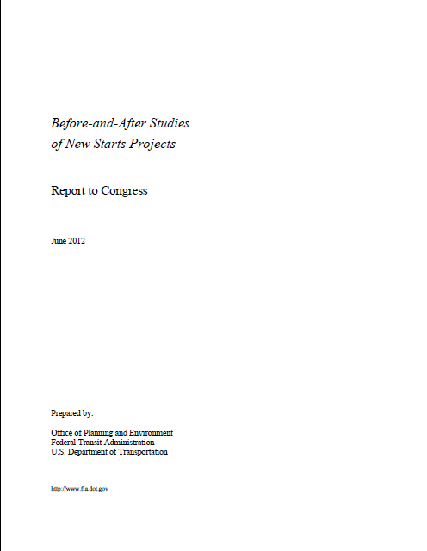
Cleveland BRT: Before & After Study
Features | Before | After
Running time | 46 minutes | 36 minutes
Weekday ridership | 8,900 | 14,300
Annual ridership | 3,056,289 | 4,800,000
Operating costs | $7,000,000 | $8,200,000
Cost per trip | $2.29 | $1.71

Slide 7
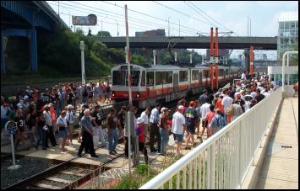
HealthLine
Exclusive Right of Way

Slide 8
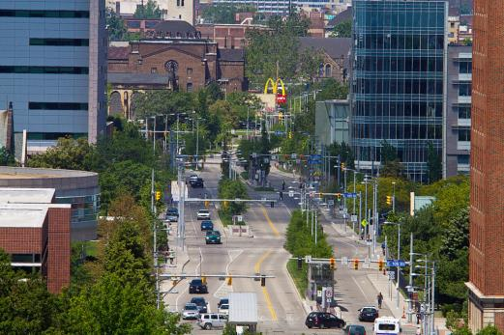
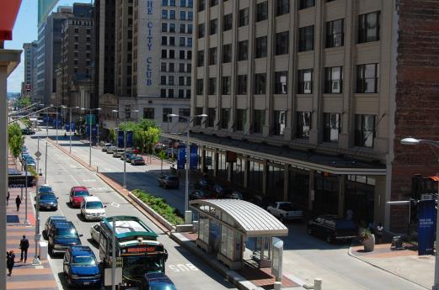
Euclid Corridor HealthLine Bus Rapid Transit
5.5 miles long
36 stations
Complete Street
Building face to building face
Transit priority
Pedestrian and bicycle friendly
Landscape/hardscape treatment
Pubic Art - Integrated/stand-alone

Slide 9
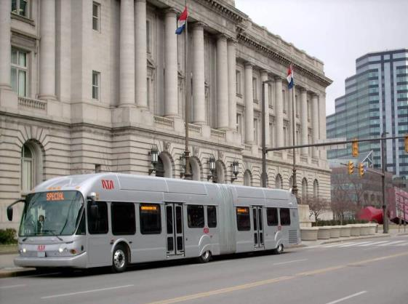
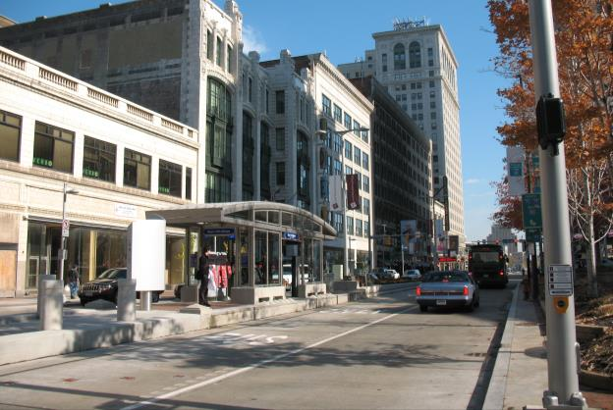
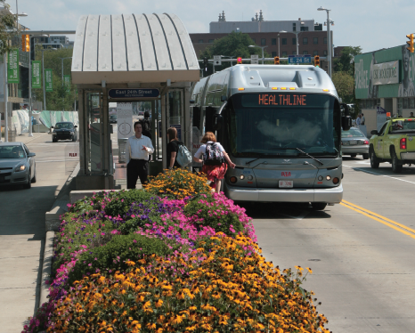
Bus Rapid Transit Amenities
Bus only, exclusive right-of-way
High-frequency all day service
Bus priority preferential treatments
Branding
Off-bus fare collection
Level boarding
Intelligent transportation systems (ITS)
High-quality, highly visible stations

Slide 10
Transitway Alternatives

Slide 11
Center Median

Slide 12
Curbside

Slide 13
Offset

Slide 14
HealthLine Transitway

Slide 19
Transit Signal Priority

Slide 20
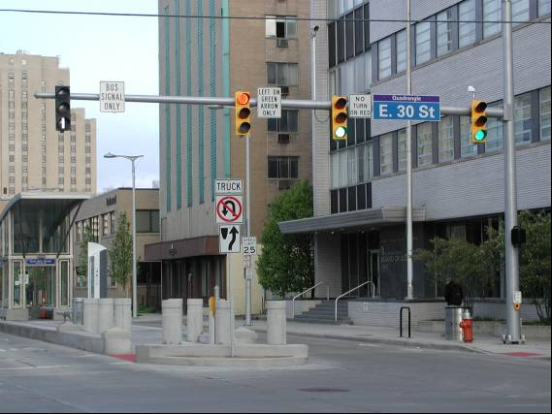

Slide 21
Vehicles

Slide 24
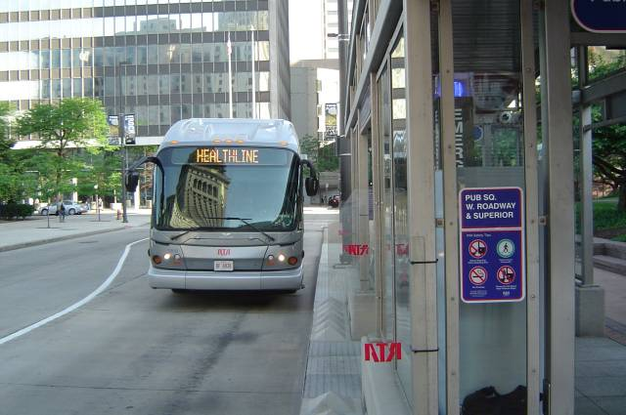
Precision Docking

Slide 27
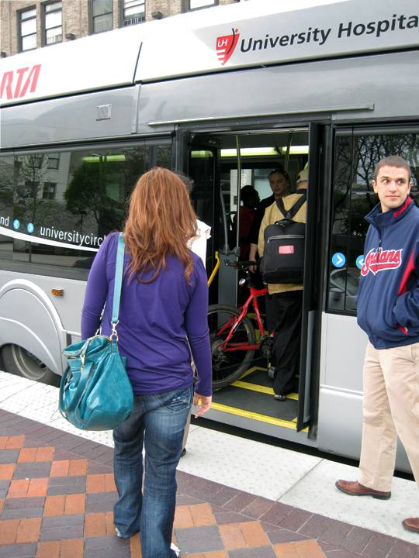
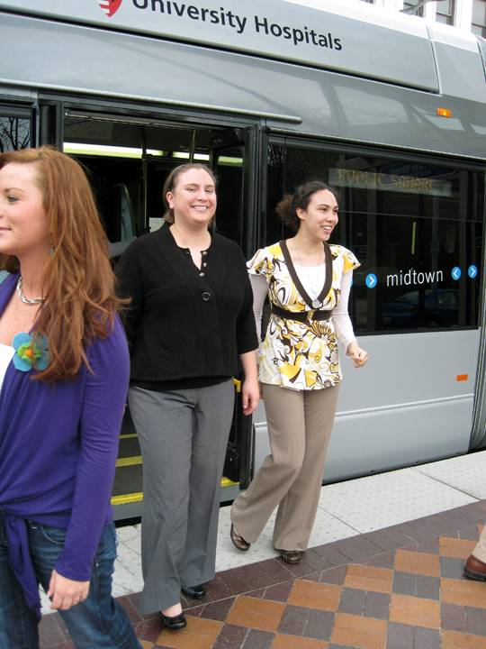
Level Boarding

Slide 30
Stations

Slide 31
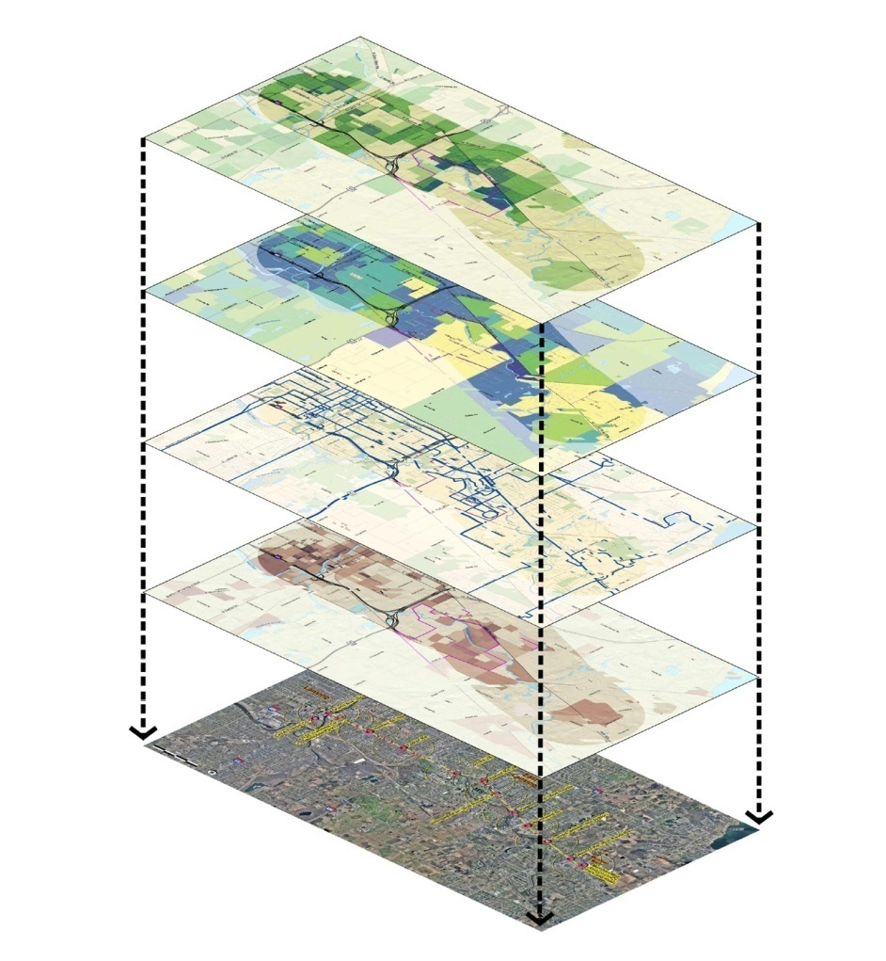
Layering of Forces/Issues
Inputs to be Considered
Feeder Bus Lines
Major Activity Nodes
Major Institutions
Higher-Density Residential Areas
Major Employment Centers
Transit Dependent Populations
Park-and-Ride Facility Sites
Signalized Intersections
Planned Developments
Environmental Constraints

Slide 32
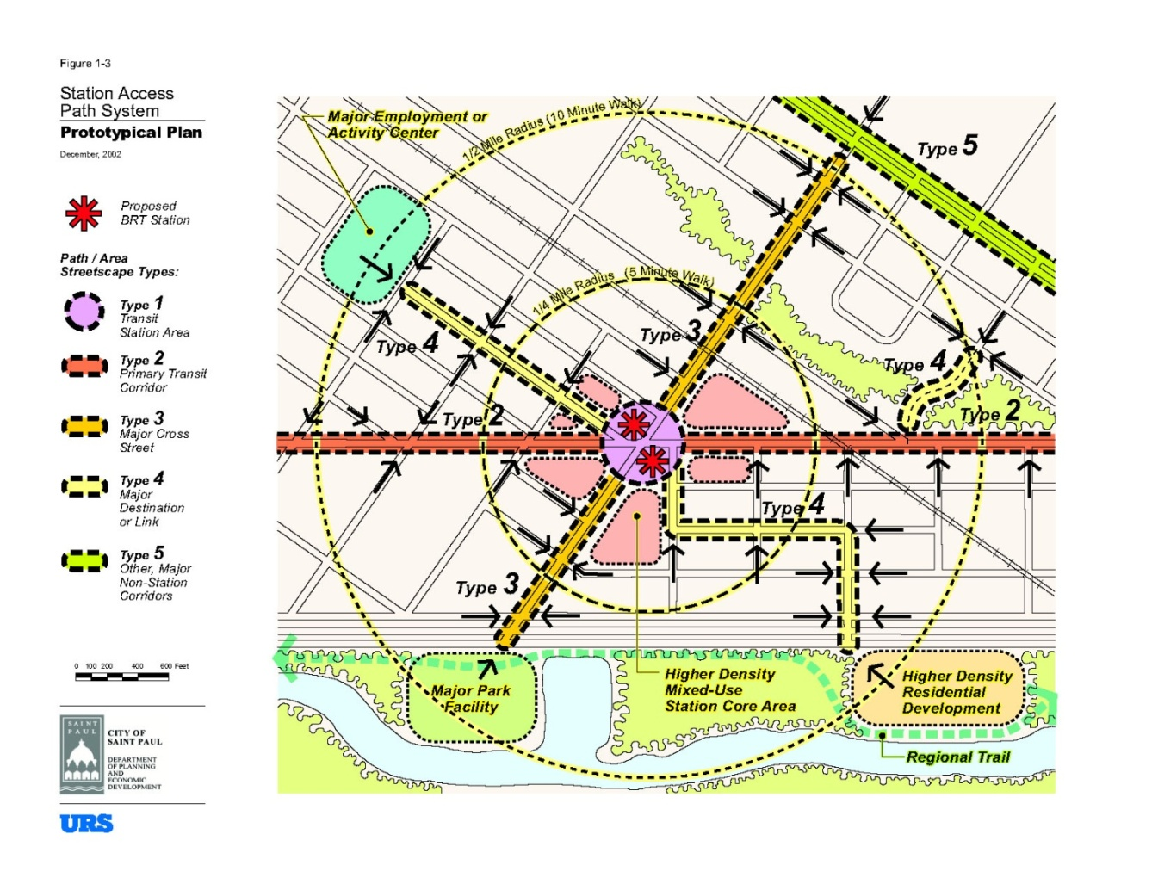
Transit Station Access

Slide 35
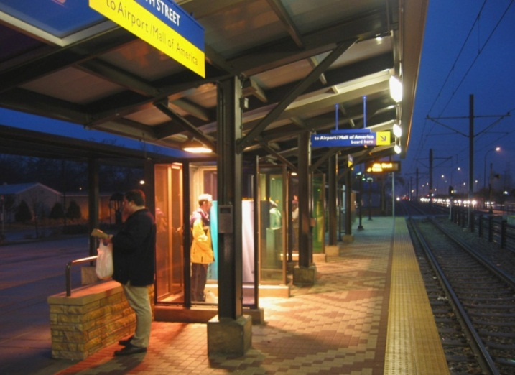
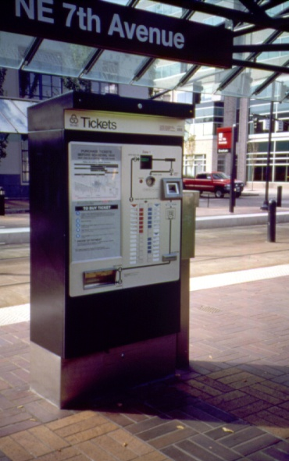
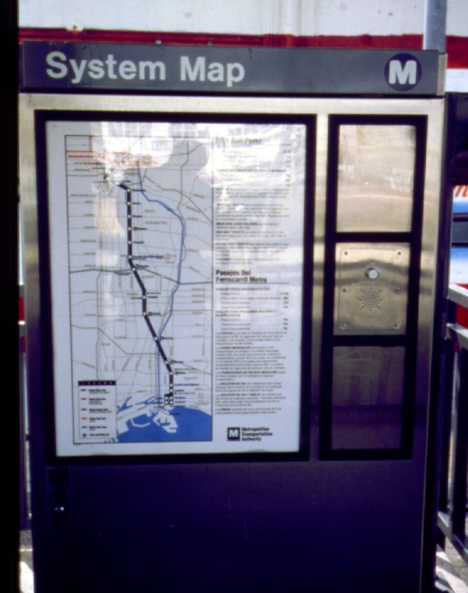
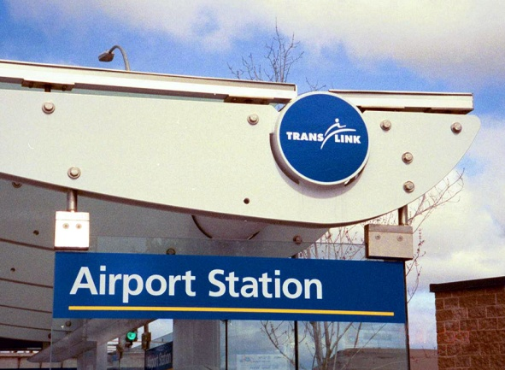
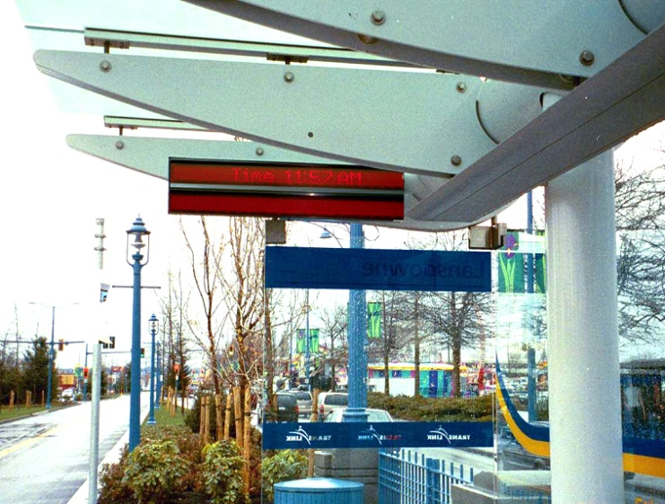
Station Components
Lighting
Ticket Vending
Maps and Information
Station Name
Passenger Information Displays

Slide 38
Streetscape

Slide 41
Landscape

Slide 43
Public Art

Slide 45
Pedestrian Protection

Slide 47
Branding

Slide 50
Economic Development

Slide 51
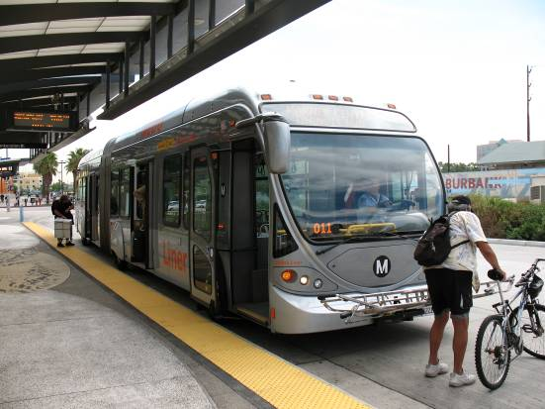
Benefits to Transport System Users
Greater access:
jobs,
retail,
health services, education and
cultural facilities
Travel time savings
Travel cost savings
Notes:
Good

Slide 52
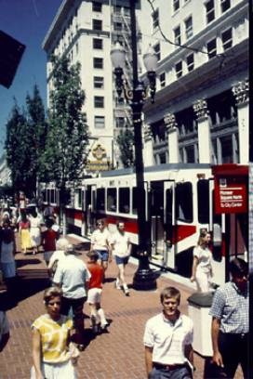
Benefits to Community
Contain the costs of infrastructure
Improve community amenities
Increase regional competitiveness
Increase gross regional product
Sustainable development
Notes:
Good

Slide 53
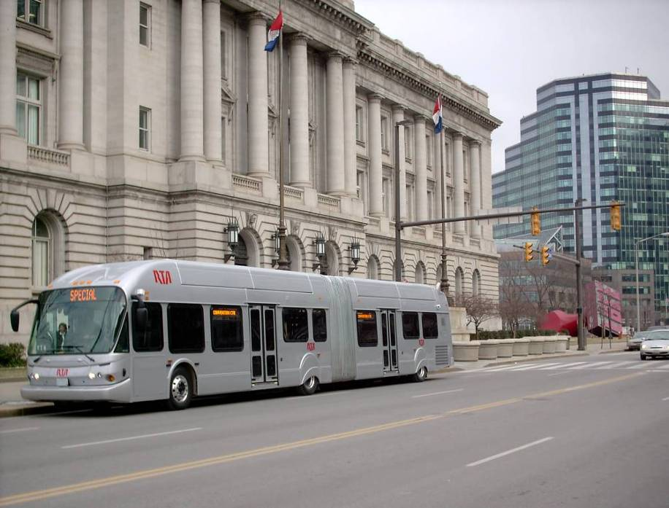
Public Agencies Benefits
More revenue to local government
A typical state or local government could realize a 4 to 16 percent gain in tax revenues.
The Washington Metrorail system is expected to generate $2.1 billion in tax revenues for Virginia over 30 years.
Development surrounding the Station in Eden Prairie, MN, will annually return over $400,000 in residential property taxes and nearly $300,000 in retail property taxes.
Notes:
Good

Slide 54
Private Developer Benefits
Improves access
Provides passenger traffic
Reduces parking requirements
Faster absorption rates
Lower vacancies
Land values increase
Higher rents
Higher Return on investment (ROI)
In Cleveland, property values more than doubled along the corridor.
“Developers gravitate toward places where they see investment happening. There's no question the Euclid Corridor is a catalyst…" Lillian Kuri, Director of Special Projects for the Cleveland Foundation.
Notes:
Good

Slide 55
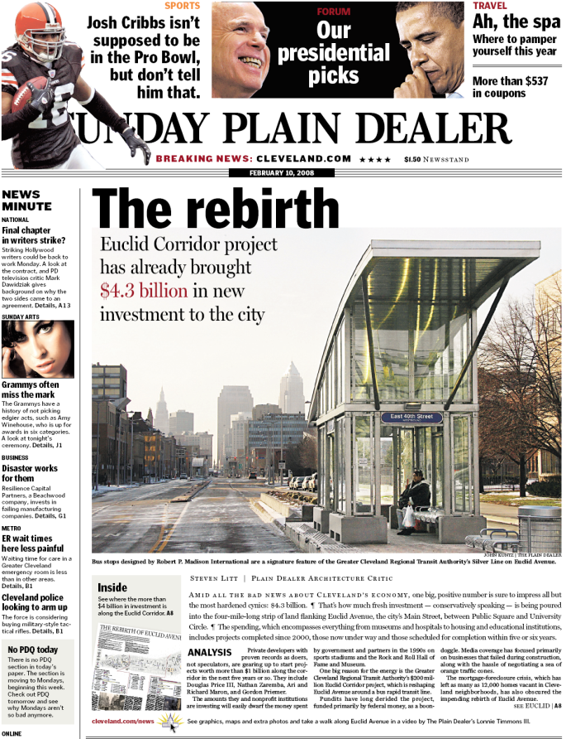
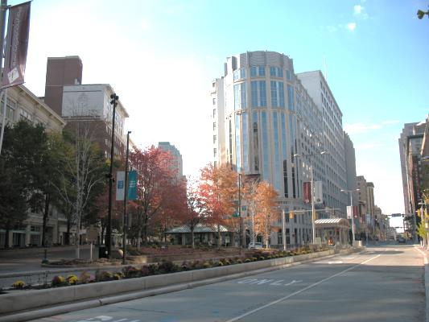
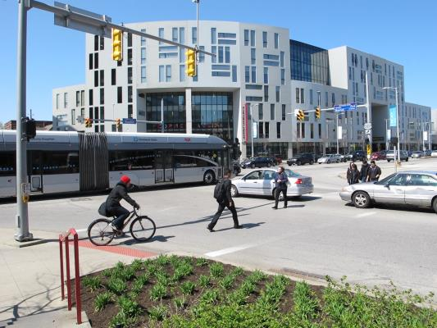
The Power of Permanence
Notes:
$6 Billion in Economic development
The Power of Permanence

Slide 56
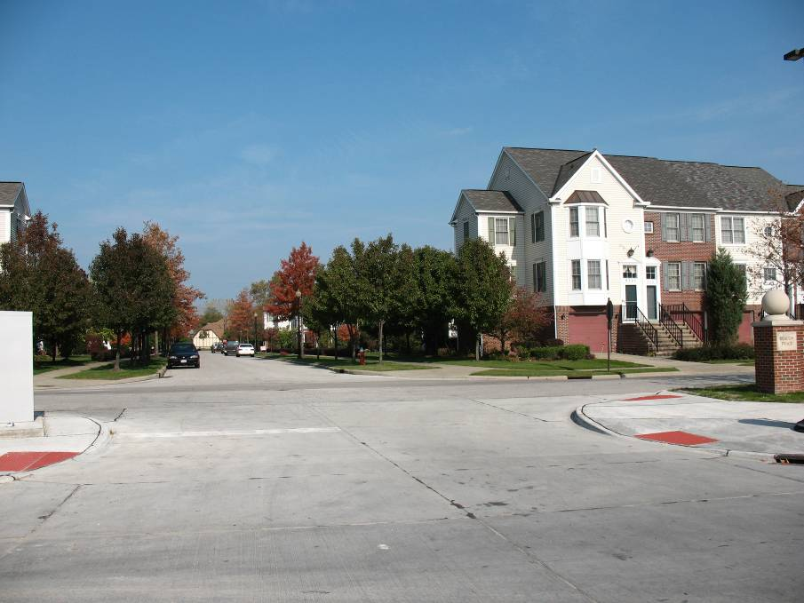
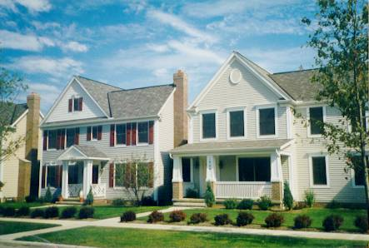
Midtown
The price of an acre of land in the long-blighted Midtown area has doubled in the past five years from $200,000 to $400,000.
Notes:
Include

Slide 57
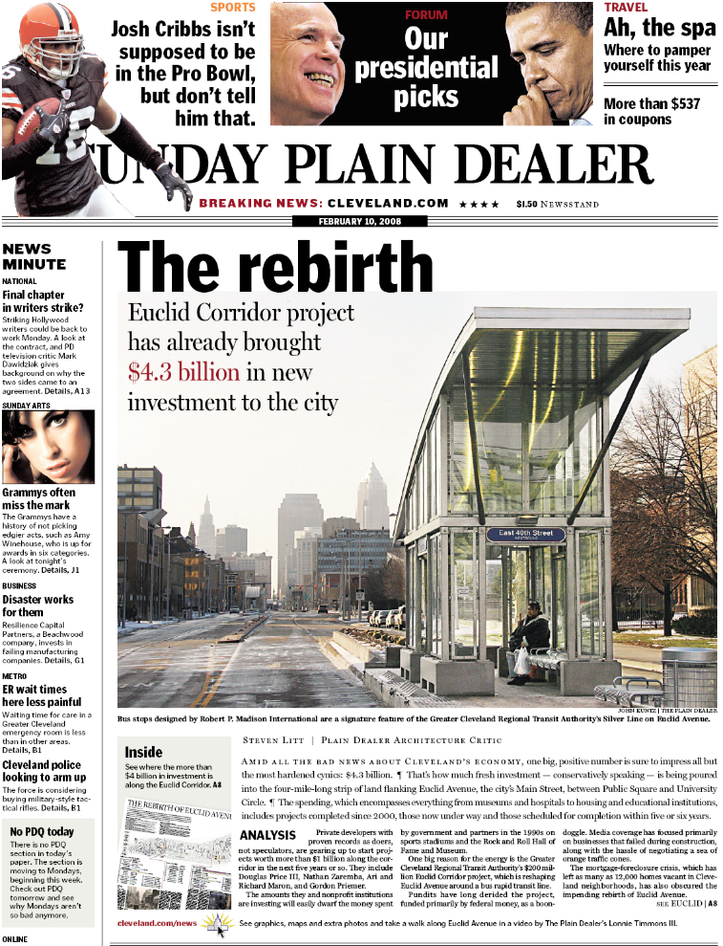
Long-Term Economic Benefit
Forecasted Economic Benefits
Commercial Development | 7.9 M ft ²
Residential units | 5,400
Capital investment | $6.0 B
Local tax generated | $ 62.2 M
RTA sales tax | $ 1.9 M
Jobs created | 13,000
Source: BPP & Associates Economic Impacts of the Euclid Corridor BRT Project; Greater Cleveland RTA 2000.
Notes:
Include

